Slide 1



Python Bootcamp
Presents
Featuring

Slide 2
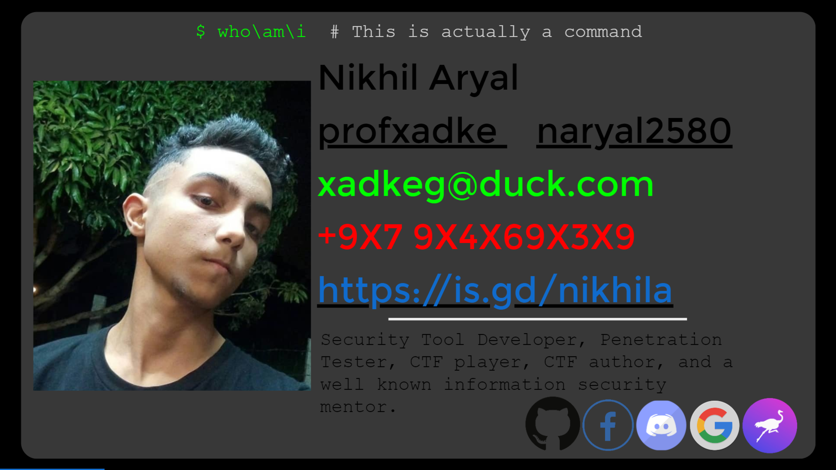
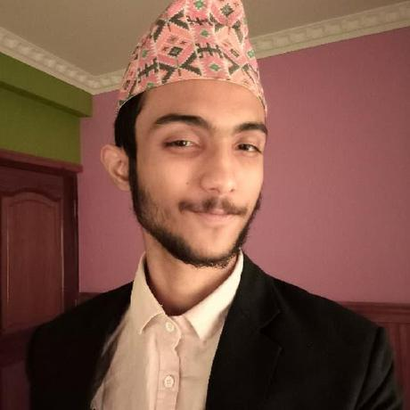

Slide 3
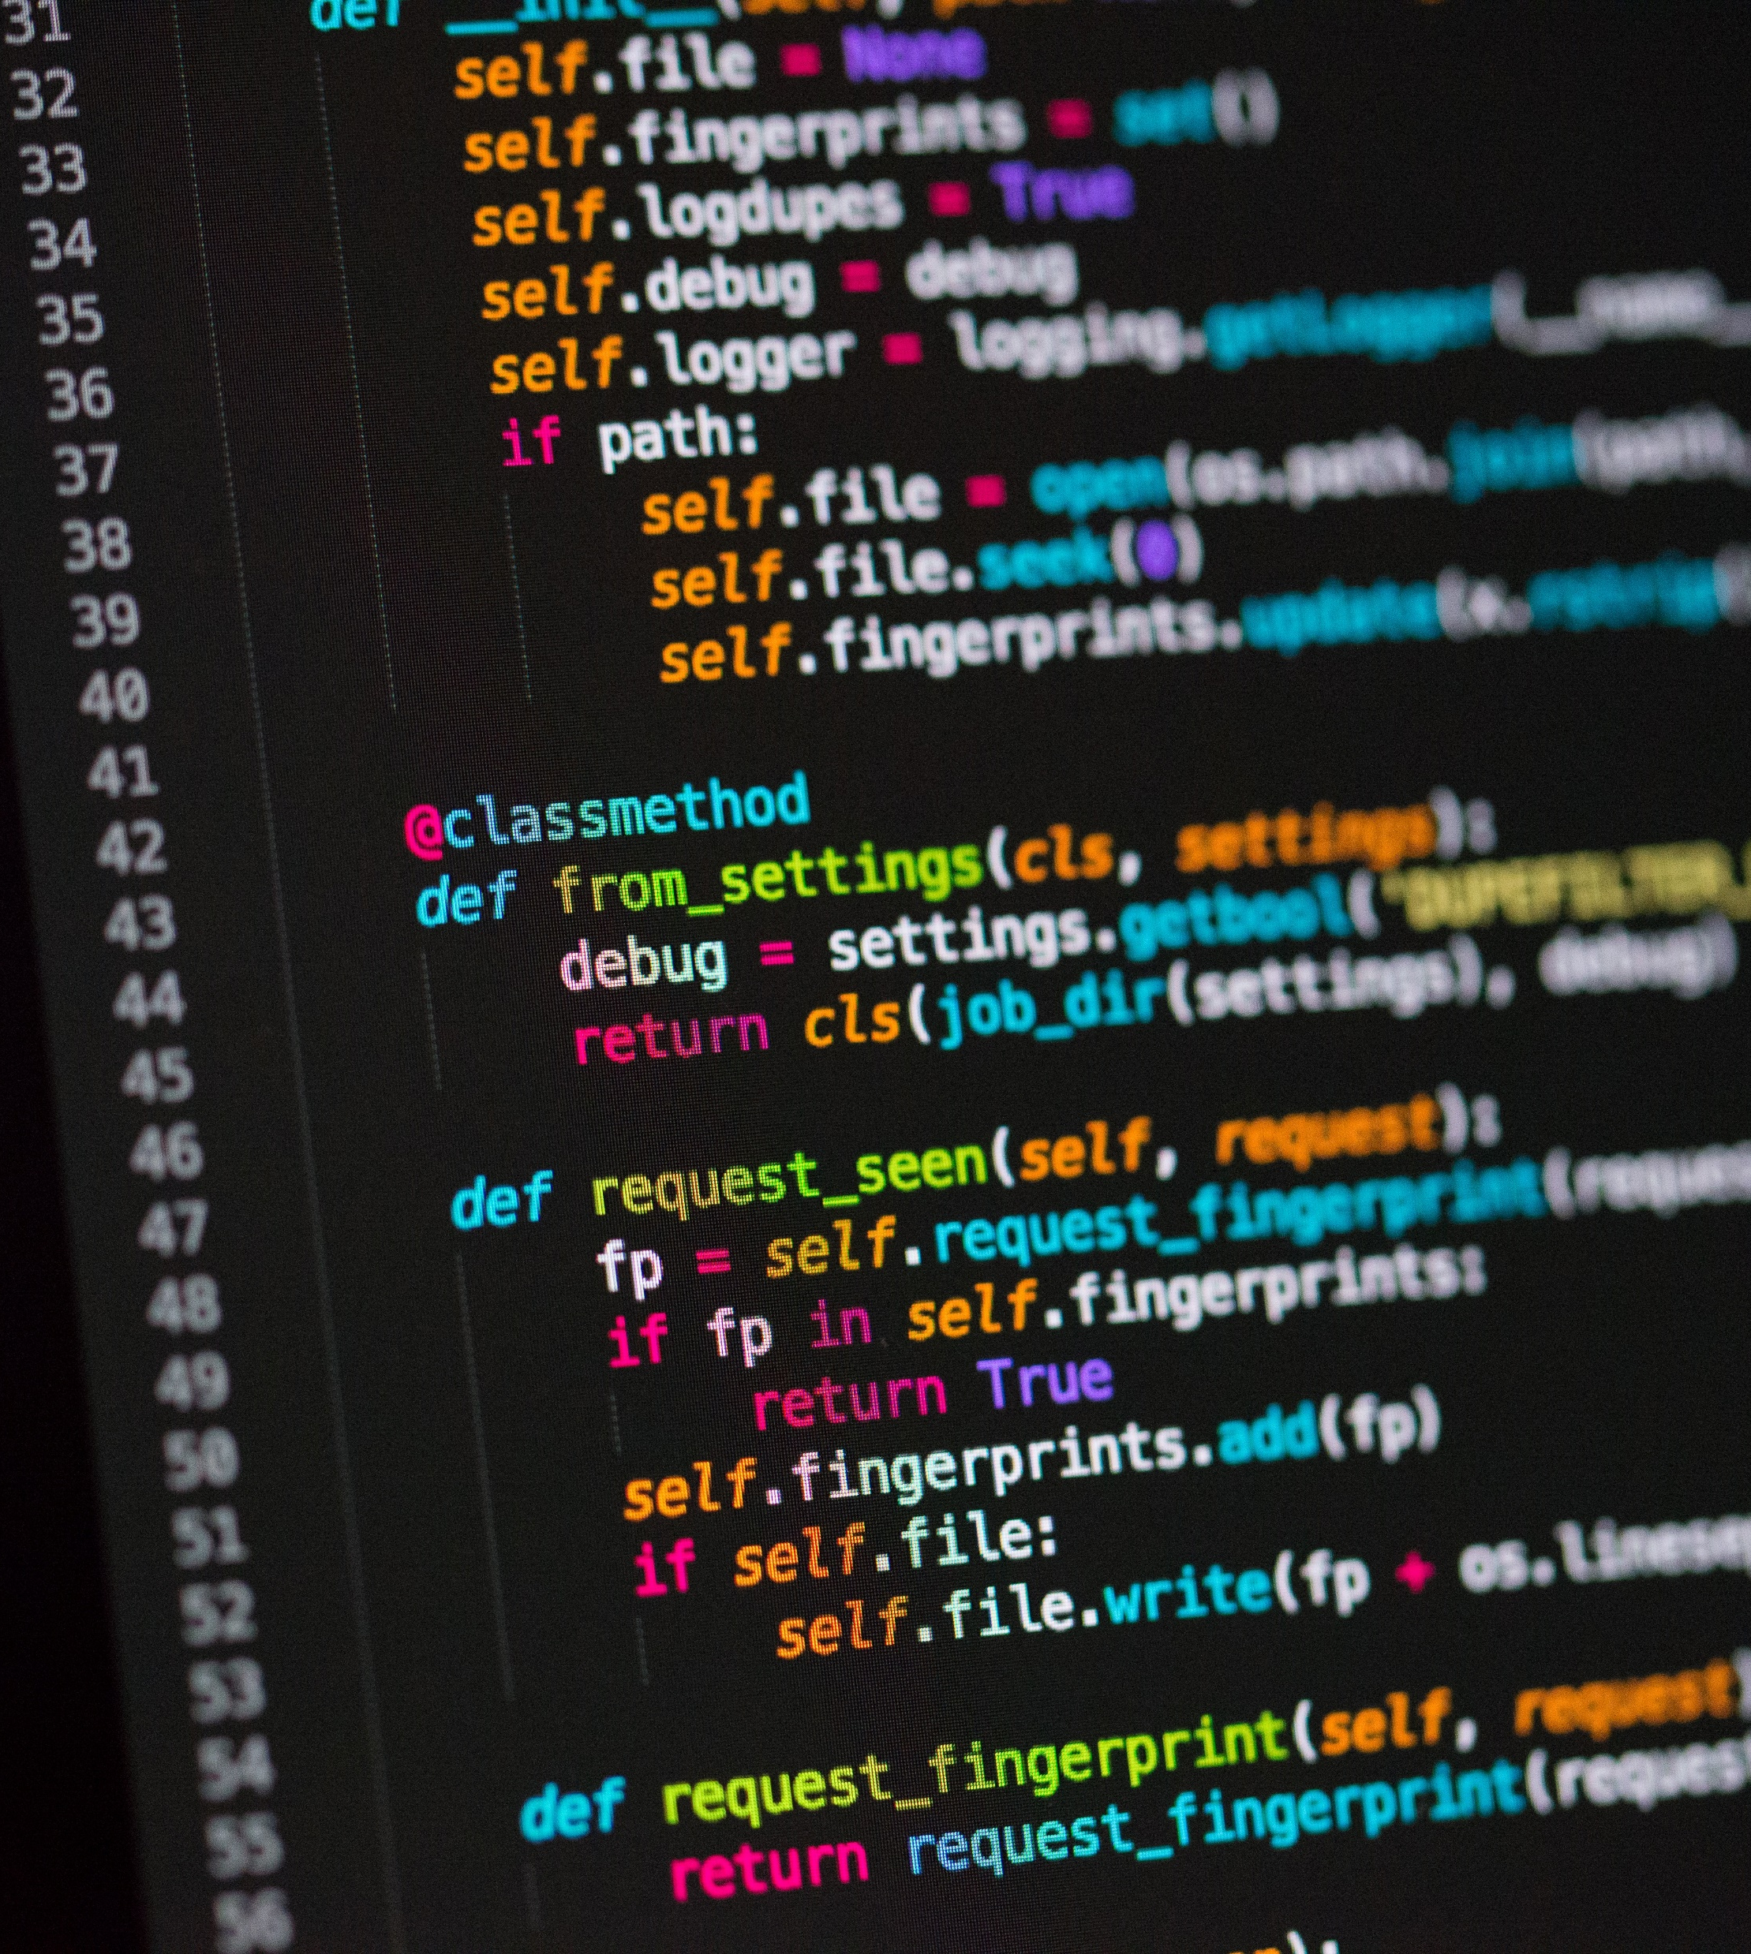


Python Basics
Compiled vs Interpreted Language(s)
Which Python and, Why? Python2 or Python3
Python3 Intro!

Slide 4

Break Time!

Slide 5
FastAPI: Intro
Pydantic Models
Congruency, and Async / Await
Request Parameter(s), Body, File, Headers, and Cookie(s)
API Error Handling, CORS
Static files, and Templates

Slide 6
FastAPI: Advanced
SQL Relational Database
Custom Response(s), status code(s)
Response Header(s), Cookie(s)
FastAPI, behind a proxy/reverse proxy.
Implementing Web Socket(s)
Including WSGI ( Flask, Django, etc. ) Model(s)

Slide 7
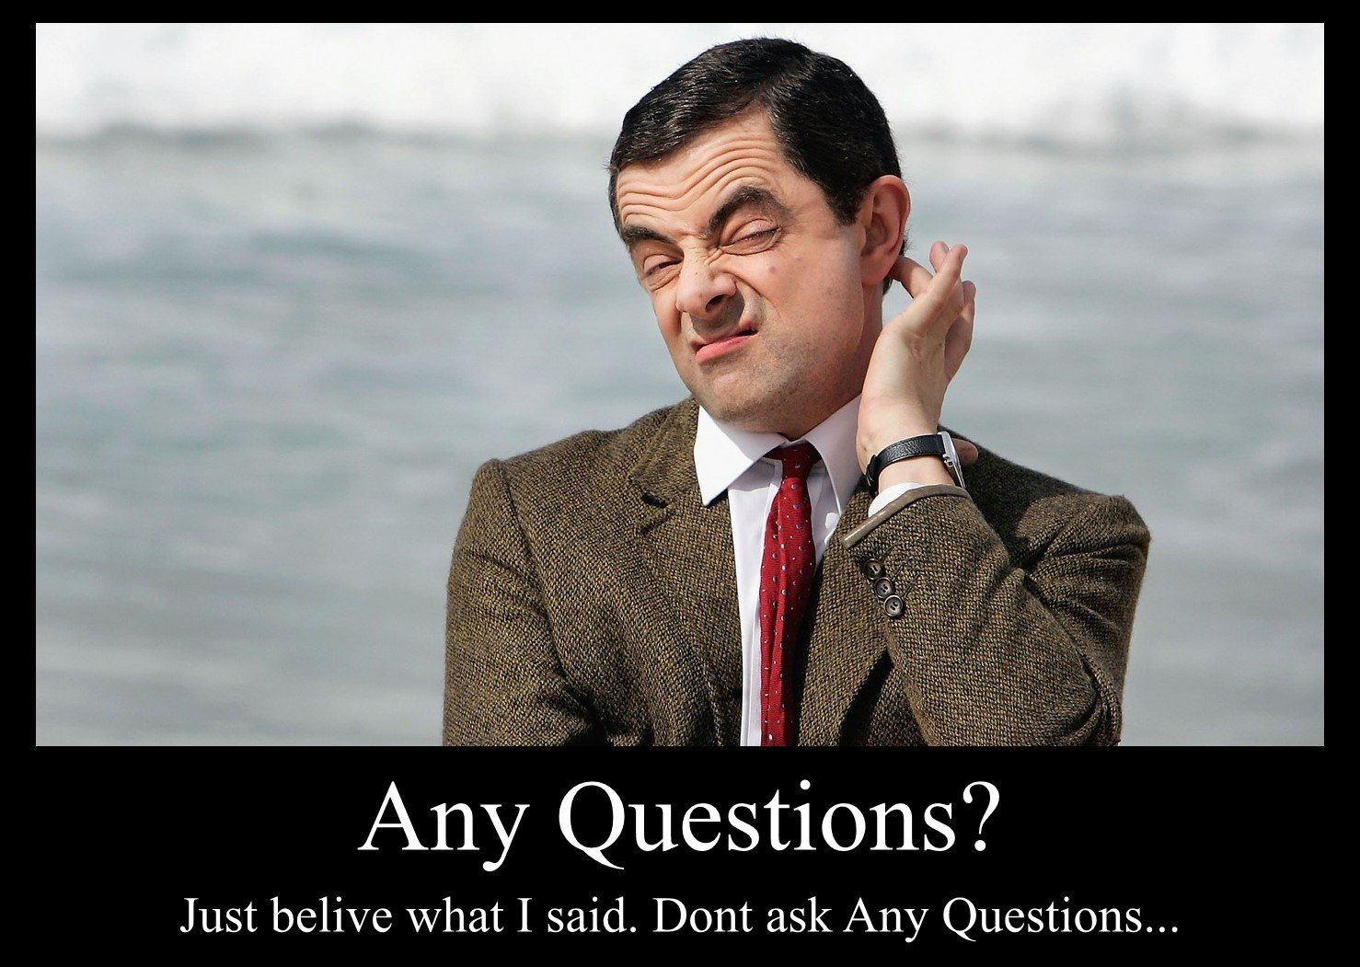

Slide 8

Presented by:
Prepared by:

